Slide 1
Working with Pods

Slide 2

App Deployment Workflow
Creating a Pod Manifest (YAML) Deploying a Pod
Multi-container Pod example Recap
Overview

Slide 3
App Deployment Workflow

Slide 4



</>
Registry
YAML
blah
blah YAML
POST
apiserver{}
Quick run through these bits…
Our main focus
Our main focus

Slide 5
Up Next:
Creating a Pod Manifest (YAML)

Slide 6
Creating a Pod Manifest (YAML)

Slide 8
Alpha
v1alpha1 v1alpha2

Slide 9
Alpha
v1alpha1 v1alpha2

Slide 10
Alpha
v1alpha1 v1alpha2

Slide 11
Alpha
Beta
GA/stable
v1alpha1 v1alpha2
v1beta1 v1beta2
v1

Slide 12



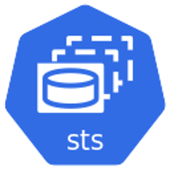


{}
api
API
kind: Deployment apiVersion: apps/v1
...
apps
kind: DaemonSet apiVersion: apps/v1
...
v1
v1
v1
v1
apiserver{}
kind: ReplicaSet apiVersion: apps/v1
...
batch
v1
v1beta1
kind: StatefulSet apiVersion: apps/v1
...

Slide 13
{}
api
API
apps
v1
v1
v1
v1
apiserver{}
batch
kind: CronJob apiVersion: batch/v1beta1
...
v1
v1beta1

Slide 14












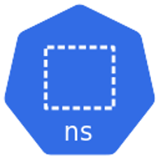
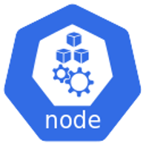


{}
api
API
WORKLOADS APIS
apps
storage.k8s.io
core ‘’
kind: Pod apiVersion: v1
...
v1
v1
v1
v1
v1
v1
networking.k8s.io
v1
v1
apiserver{}
v1
v1
v1
batch
v1beta1 v1
. . .
v1
v1
v1
v1
v1beta1
v1
v1
v1

Slide 15

{}
api
API
Pod object definition
API sub-group: [core “”]
metadata (ObjectMeta)
name (string)
annotations (object)
labels (object)
spec (PodSpec)
nodeName (integer)
containers (container array)
name (string)
image (string)
imagePullPolicy (string)
ports (ContainerPort array)
apiserver{}

Slide 16

{}
api
API
Pod manifest
Pod object definition
API sub-group: [core “”]
metadata (ObjectMeta)
name (string)
annotations (object)
labels (object)
spec (PodSpec)
nodeName (integer)
containers (container array)
name (string)
image (string)
imagePullPolicy (string)
kind: Pod apiVersion: v1 matadata:
name: test-pod labels:
ver: 1.0 spec:
containers:
- name: main
image: web-server:1.0 imagePullPolicy: Always ports:
containerPort: 8080
apiserver{}
ports (ContainerPort array)
…

Slide 17


<app>

Slide 18
Up Next: Deploying a Pod

Slide 19
Deploying a Pod

Slide 20
<app>

Slide 21
Up Next:
Multi-container Pod Example

Slide 22
Multi-container Pod Example

Slide 23


<app>
<hlpr>

Slide 24
Quick Recap

Slide 25
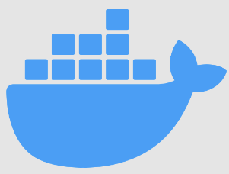
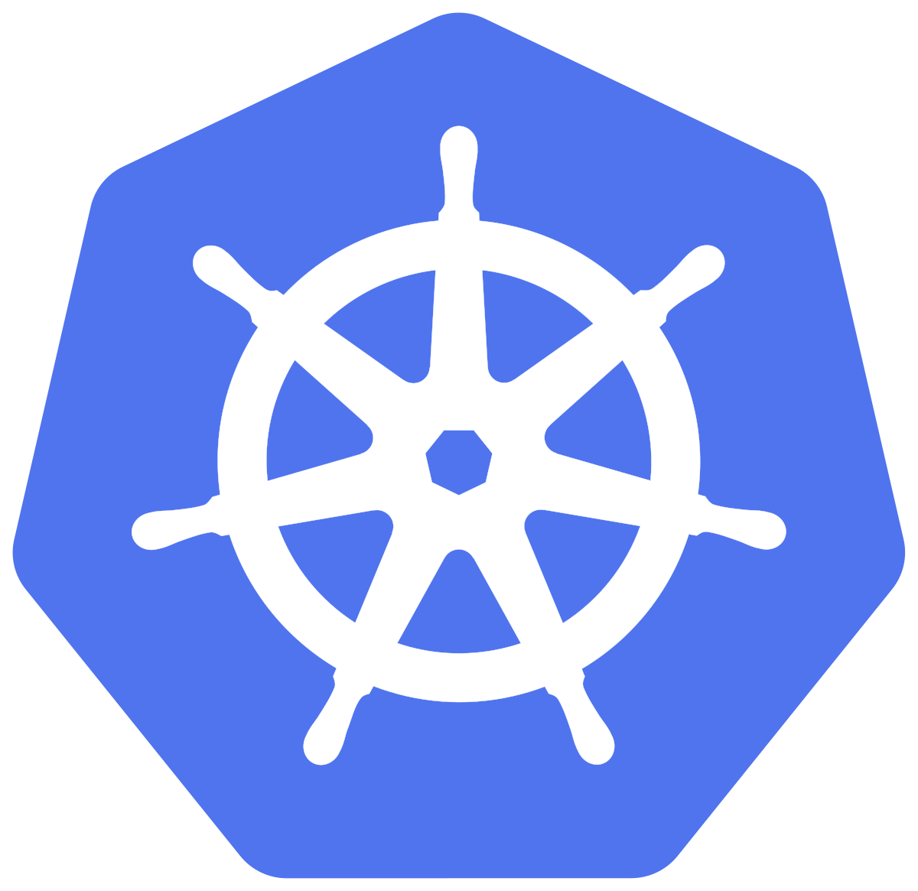
Virtual Machine
Container
Pod
Atomic units of scheduling

Slide 26



<Ctr1>
<Ctr2>
Node

Slide 27
kind: Pod apiVersion: v1 matadata:
name: test-pod labels:
ver: 1.0
spec:
containers:
- name: main
image: web-server:1.0 imagePullPolicy: Always ports:
containerPort: 8080

Slide 28
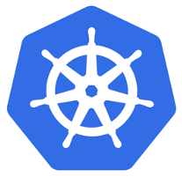
K8s cluster
kind: Pod apiVersion: v1 matadata:
name: test-pod labels:
ver: 1.0
spec:
containers:
- name: main
image: web-server:1.0 imagePullPolicy: Always ports:
containerPort: 8080
POST (HTTPS)
{}
api srv

Slide 29
Up Next:
Kubernetes Networking with Services

